Slide 1

Crop Production Analysis in India
By Kalpesh Deshpande

Slide 2

Overview
India is one of the world's largest agricultural producers, with a diverse array of crops grown across its varied agro-climatic zones. Understanding and analyzing crop production is crucial for improving agricultural productivity, ensuring food security, and making informed policy decisions.
This project aims to conduct a comprehensive analysis of crop production in India using data analysis, statistical techniques, and modeling.

Slide 3
Objectives
1. Data Collection and Cleaning: Gathering historical crop production data from reliable sources, such as government databases and agricultural reports, and preprocess it for analysis.
2. Exploratory Data Analysis (EDA): Utilizing libraries like NumPy, Pandas, Seaborn, and Matplotlib to perform EDA, uncovering patterns and trends in crop production over time and across different regions.
3. Statistical Analysis: Applying statistical methods to analyze the factors affecting crop yields, such as weather conditions, soil quality, and irrigation practices.
4. Modeling and Forecasting: Developing predictive models to forecast future crop yields, helping stakeholders make data-driven decisions.

Slide 4
Tools and Libraries
- NumPy: For numerical computations and handling multi-dimensional arrays.
- Pandas: For data manipulation and analysis, particularly for working with tabular data.
- Matplotlib: For creating static, interactive, and animated visualizations.
- Seaborn: For statistical data visualization, making it easy to create informative and attractive graphs.

Slide 5
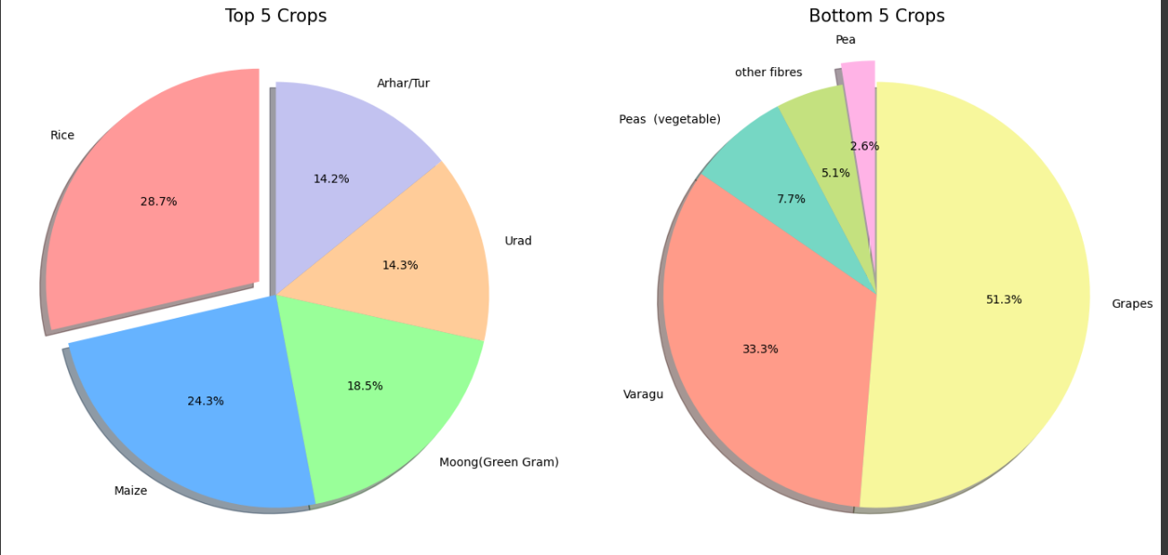
Details

Slide 6
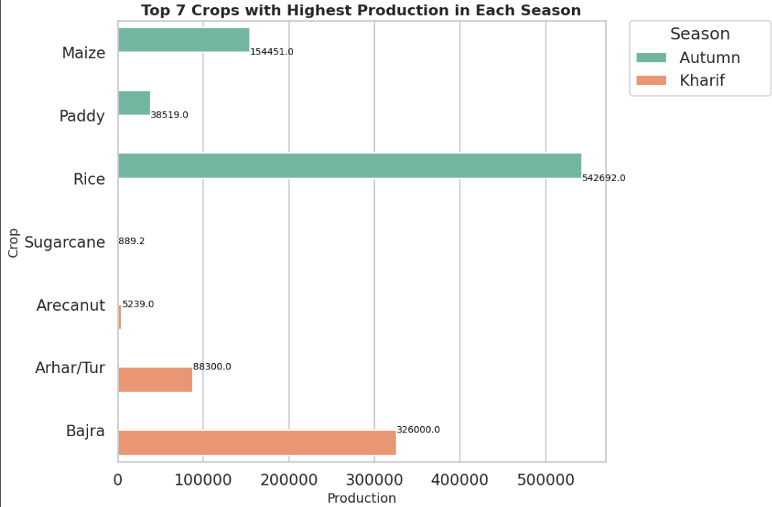

Slide 7
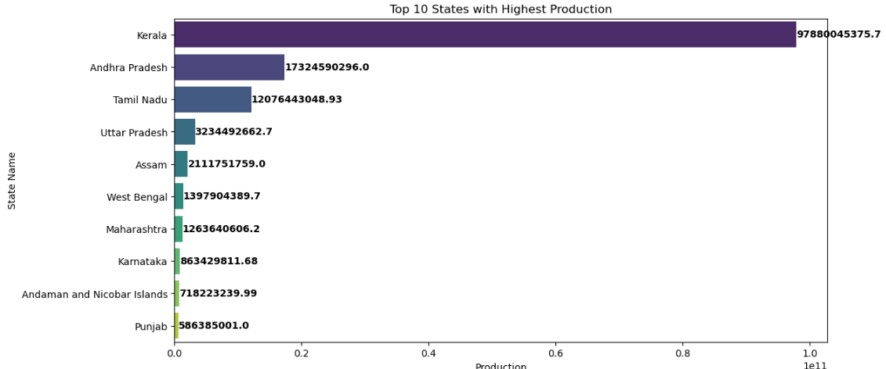
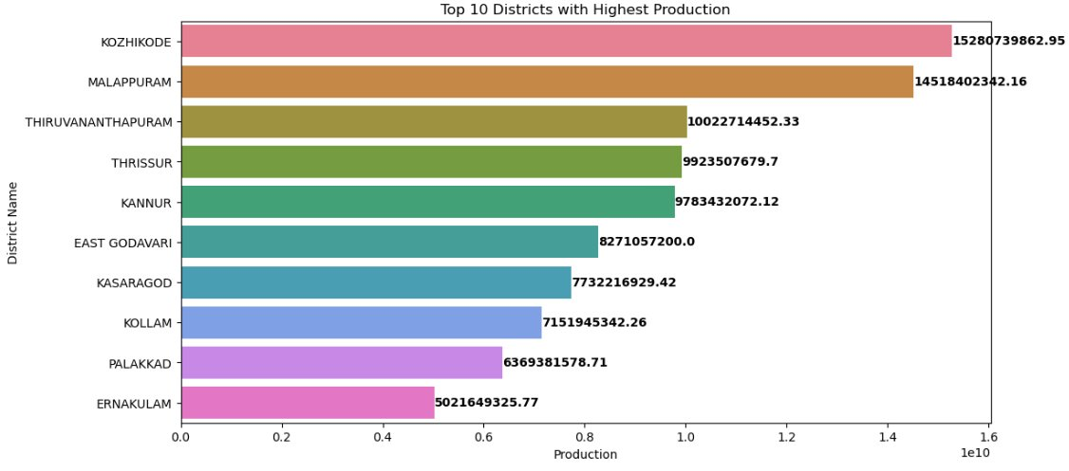

Slide 8
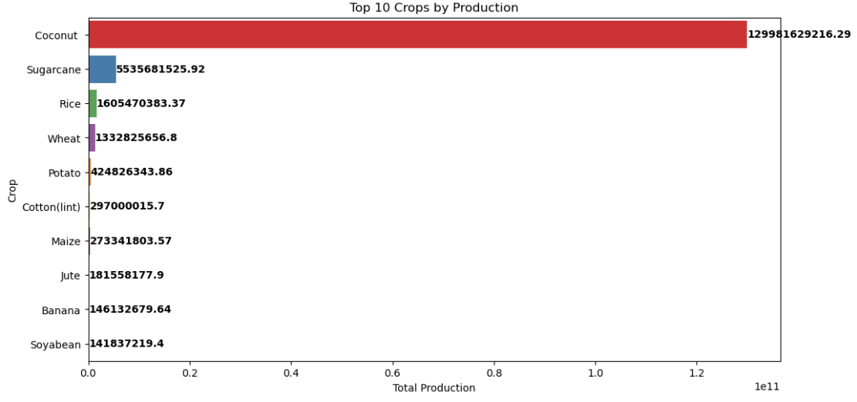

Slide 9
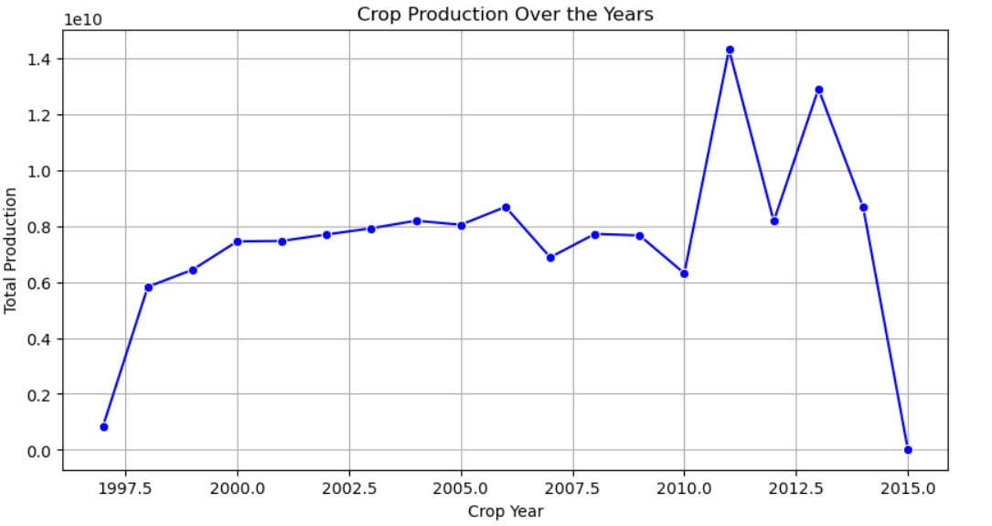

Slide 10
Thank you

